Slide 1
ENSE 470, Milestone 1
ByteThis Software
Taylor Petrychyn, Alwin Baby, and Konstantin Kharitonov
January 18th, 2017

Slide 2
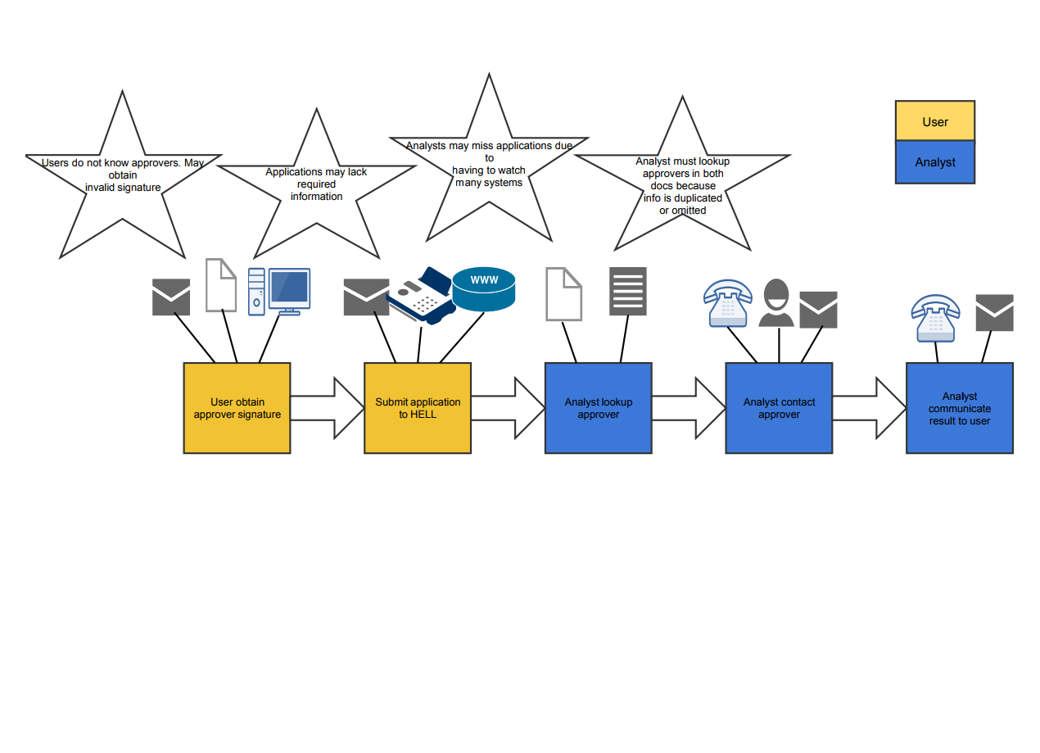
Current State Value Stream Map (VSM)
Notes:
Taylor

Slide 3
Step 1: User Obtains Approver Signature
Via email, signature or digital signature
Contacted through email, fax or web
Might obtain invalid signature from wrong approver
Notes:
Taylor

Slide 4
Step 2: Submit Application
Analyst receives request via email, fax or web (webform)
Non-webform requests lack required information
Application request may be missed
Notes:
Alwin

Slide 5
Step 3: Analyst Lookup approver
All requests are vetted
Uses Excel spreadsheet and/or PDF to find approver
Users use acronyms in requests
Notes:
Alwin

Slide 6
Step 4: Analyst Contacts Approver
Contact through email or phone
Uses both files to search for correct approver
Document info can be duplicated or omitted
Notes:
Kon

Slide 7
Step 5: Analyst Communicates Result
Contacts back through same medium
Informs where request is granted or denied
Respond process can take some time
Notes:
Kon

Slide 8
Group reflection
How did you feel about this milestone? What did you like about it? What did you dislike?
  Simple yet important task. We enjoyed creating the VSM, learning about the process.
  Multiple restarts due to poor online tools
What did you learn about yourself as you collaborated and worked through this milestone?
  We haven’t fully utilized this process before
How will you use what you have learned going forward?
  For future assignments
What “stuff & things” related to this milestone would you want help with?
  Finding reliable software for VSM creation

